Slide 1
The New Modern Application Platform Session 1: Cloud Native Overview
“Bridging the growing chasm between developers and infra engineering”
Ellis Paul, Senior TAM
February 2021

Slide 2
10 Classes over 5 months
Lecture component - ~2 hours
Lab/Homework component
Office Hours
What we will teach is based on Open Source products
Today’s Class
Agile CI/CD and DevOps – what the Developers are doing
12 Factor Apps
Brief overview of git, Docker, and Kubernetes
How current Infra is not meeting needs
Cloud Provided Infra Demo
Navigating the Linux Shell

Slide 3
The new Application Platform
What are we seeing in our customers as Infrastructure folks?
What is driving this change?
Customers are trying to reduce legacy Application licensing costs (i.e. Oracle)
Business requires faster (agile) development of new applications – deliver new functionality in weeks, not months or years
The traditional Infrastructure groups we deal with are not keeping up with demands
Developers are sidestepping Infra and going straight to cloud provider – most times with terrible consequences – and still not getting what they need!
Notes:
Happening in my customer. Trying and failing to upgrade – complex and risky. What they were trying to do had become too complex and introducing issues
Trying to reduce cost – many legacy systems very expensive – becomes “easy” to save millions of $
“Agile” – new way of doing development, 2-weeks sprints etc. Every 2 weeks code is developed and ultimately will go into production. Historically these development cycles have been months if not years. E.g. Microsoft, e.g. our own Cloud-based products vs. on-prem
Allows new features to be pushed into production every few weeks in a stable way – enables competition (including with public cloud)
Need dynamic and API-driven environment. Even creating a VM today often includes manual, “email-driven” tasks to (e.g.) get and register IP and FQDN, doesn’t work with cloud native stuff.

Slide 4
Cloud Native Applications
A Definition
The Cloud Native Computing Foundation, a project of The Linux Foundation, defines cloud-native applications as follows:
Containerized---Each part (applications, processes, etc.) is packaged in its own container. This facilitates reproducibility, transparency, and resource isolation.
Dynamically orchestrated---Containers are actively scheduled and managed to optimize resource utilization.
Microservices oriented---Applications are segmented into microservices. This segmentation significantly increases the overall agility and maintainability of applications.
Notes:
Internet-provided definition – much content out there
Trying to “containerize” applications. Package an application in something very portable, usually using Docker or similar. Function wrapped in a container. Containers can typically run “anywhere” – public cloud, on-prem, even on your laptop. Not completely unlike virtual machines but going a layer deeper and abstracting the operating system.
Dynamic orchestration – everything in the development process now automated. When the dev pulls their code from the repository and ”pushes” it back, it will get inspected automatically, security scanned, tested and compiled automatically, pushed into different registries, maybe even create a K8S cluster automatically then pushed to K8S cluster and tested there. – something like Jenkins or our CodeStream in vRA
Microservices: legacy big “monolithic” bundle of functions (e.g. Word – can do all sorts of things, very complex). Micrososervices breaks down every single function into micoroservices – a “write to disk function” might be its own microservice – a legacy application might become a 100 microservices – if you need to change something you can change a single microservice if you have to.

Slide 5
Characteristics of Cloud Native Application Architectures
These characteristics are paraphrased from Migrating to Cloud-Native Application Architectures.
twelve-factor apps. The formula for building twelve-factor apps is a set of patterns that optimize application design for speed, safety, and scale.
Self-service agile infrastructure. Cloud platforms that enable development teams to operate at an application and service abstraction level, providing infrastructure-level speed, safety, and scale.
API-based collaboration. An architecture pattern that defines service-to-service interaction as automatically verifiable contracts, enabling speed and safety through simplified integration work.
Antifragility. Improving the robustness of systems to deliver speed and scale.
Notes:
You’re going to hear about 12-factor apps – formula for building CNA
Self-service – devs trying to automate all this, they can’t be sending emails or creating tickets, they need API access to everything. Return times of seconds or minutes not days and weeks
Everything needs to talk as code, If need an IP address or a certificate I need to request and generate via code.
Breaking things apart but still create a robust system

Slide 6
Twelve Factor Apps (https://12factor.net)
I. Codebase
One codebase tracked in revision control, many deploys
II. Dependencies
Explicitly declare and isolate dependencies
III. Config
Store config in the environment
IV. Backing services
Treat backing services as attached resources
V. Build, release, run
Strictly separate build and run stages
VI. Processes
Execute the app as one or more stateless processes
VII. Port binding
Export services via port binding
VIII. Concurrency
Scale out via the process model
IX. Disposability
Maximize robustness with fast startup and graceful shutdown
X. Dev/prod parity
Keep development, staging, and production as similar as possible
XI. Logs
Treat logs as event streams
XII. Admin processes
Run admin/management tasks as one-off processes
Notes:
Developers follow this.
All code in central repository for tracking and managing (GIT)
How is a container called and what is its dependencies A twelve-factor app never relies on implicit existence of system-wide packages. It declares all dependencies, completely and exactly, via a dependency declaration manifest
Config – devs could (up to a point) ignore infrastructure in the past, but now infrastructure becomes part of the process – when we built a K8S cluster the config also needs to be saved in the GIT cluster, changes to the K8S cluster can change functionality down the road
Apps sometimes store config as constants in the code. This is a violation of twelve-factor, which requires strict separation of config from code. Config varies substantially across deploys, code does not. (access to backing services, credentials to external services such as Amazon S3 etc)
Backing Services – try to separate e.g. LAMP, front-end middle and back – databases, SMTP services, queuing systems like Rabbit MQ etc. A deploy of the twelve-factor app should be able to swap out a local MySQL database with one managed by a third party (such as Amazon RDS) without any changes to the app’s code
“Build” converts code into an executable, release combines the “build” with “config” – (now it’s tied to an environment), “Run” or “runtime” launches process and runs the app
Processes – app is executed as one or more processes - true 12-factor process are stateless and share nothing – and data that needs to persist must be store in a stateful “backing service” typically a database
Port Binding – web services exported as a service by binding to and listening to a port, not just web services can be exported like this nearly anything can.
Concurrency – processes can scale out, across multiple containers – we don’t make our containers bigger, we add more of them!
Disposability – processes are disposable, started or stopped at a moment’s notice. Strive to minimize start-up time, graceful shutdown and also ”robust against sudden death” (cattle vs. pets)
Dev/Prod Parity – reducing gaps between dev and prod – the time gap, the personnel gap, tools gap.
Logs.- processes write their event stream to stdout. Log routers, collectors, viewers etc are managed by the execution environment – Logplex and Fluentd
One-off Admin processes such as database migration should run in the same release environment as the apps’ regular business.

Slide 7
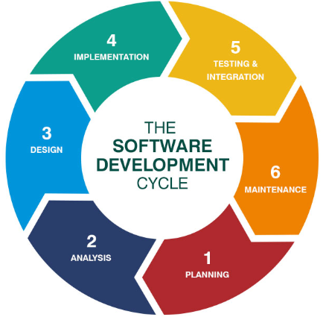
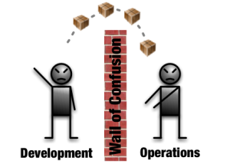
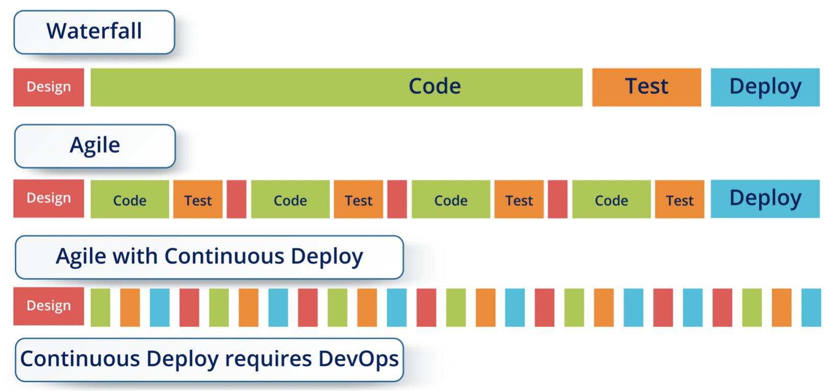
What are the Developers Doing?
Servers
Physical – Virtual – Cloud - Containers Build-It – Converged – Hyper-Converged – Composable
Application Architecture
Monolithic – N-Tier – Microservices
Waterfall Model
Monolithic
Applications
Standalone – Web-based – Enterprise – Cloud Native
Apps tightly coupled
DevOps
Agile Method
User Interface
Front-Tier
Middle-Tier
Backend-Tier
Business Layer
End-User (Web)
WebSphere WebLogic JBOSS .NET Server
Database
Database
Front-Tier
Middle-Tier
Backend-Tier
User Interface (Web)
login.war
tomcat - java
Database
Environments
Dev – QA – IAT – Prod
debit.war
apache - py
credit.war
jboss - go
Roles
Developers – Security – Operators
loan.war
apache – node.js
Notes:
Application types
Standalone
Web-based - static content – Tomcat, Apache, NGINX, HTTPD, IBM’s HIS etc.
Enterprise - dynamic content of application server - business logic – also called as Middleware – WebSphere, WebLogic, JBoss etc.
Environments – this is the order/path any version of the app will take to get to the
Development
QA
Integrated Acceptance Test - Pre-Pod - check all the integrations of the application
Production – also called as Live environment
Roles
Developers (write the code) – QA/Testers (test the code) – Project Managers- Business Owners – Business Analysts - Application Architects etc.
System Architects, System Admins, Network Architects, Network Admins, Storage Architects, Storage Admins, DB Admins, Middleware Admins, Solution Architects, Solution Engineers, Security Architects, Security Engineers etc.
3-Tier Architecture – also called Entire Architecture
Monolithic - Applications used to be monolithic earlier days - everything on the same machine - in the past browser accesses a server
3-Tier - Now, we started segregating the things - now any device including mobile devices can access these apps + messaging services can also access the applications (example: send a sms to get your account balance) - Client-tier, middle-tier and backend-tier or Presentation layer - business layer - backend/database layer
SDLC → first implementation is Waterfall –
Waterfall Model
Challenges: Infrastructure readiness, scalability, quality of product, limited release windows – release may slip/fail
What is the need?: shorter deployment cycles, faster innovation, reduced deployment failures, rollbacks and time to recover, improved communication and collaboration, increased efficiencies
Microservices
Before – tightly coupled components – slow deploy cycles waiting on integrated tests and teams
After – loosely couple components – automated deploy without waiting
Notes from the presentation: Waterfall:
Cons: longer dev cycles, dev > testing, difficult to move back, etc.
Required: well-defined reqs, frequent changes, quicker testing, etc.
Notes from the presentation: Agile Method:
Cons: Infra Readiness, Scalability, QoP, Releases slip/fail
Required: shorter cycles, reduced failures, increased efficiency

Slide 8
Terms
Waterfall – performed sequentially
Conception
Initiation and Analysis
Design
Coding
Testing
Implementation
Agile - iterative
Sprints
Enhances collaboration and teamwork
DevOps - is a set of practices that combines software development (Dev) and IT Operations (Ops). It aims to shorten the development lifecycle and provide continuous delivery with high software quality. DevOps is complementary with Agile software development; several DevOps aspects came from Agile methodology.
CI/CD – introduces automation into the stages of app development
CI – continuous integration
CD – continuous delivery / deployment
Notes:
Waterfall breaks down in test – testing in environments which are not fully representative of production.
Agile – 2-week sprints encourages more frequent communication, which leads to more innovation. “traditional infrastructure will go into this kicking and screaming”
DevOps combines dev and ops through automation
CI/CD continuous integration continuous delivery (very right in terms of code check/in/out versioning etc. Everything very standardized and automated.

Slide 9
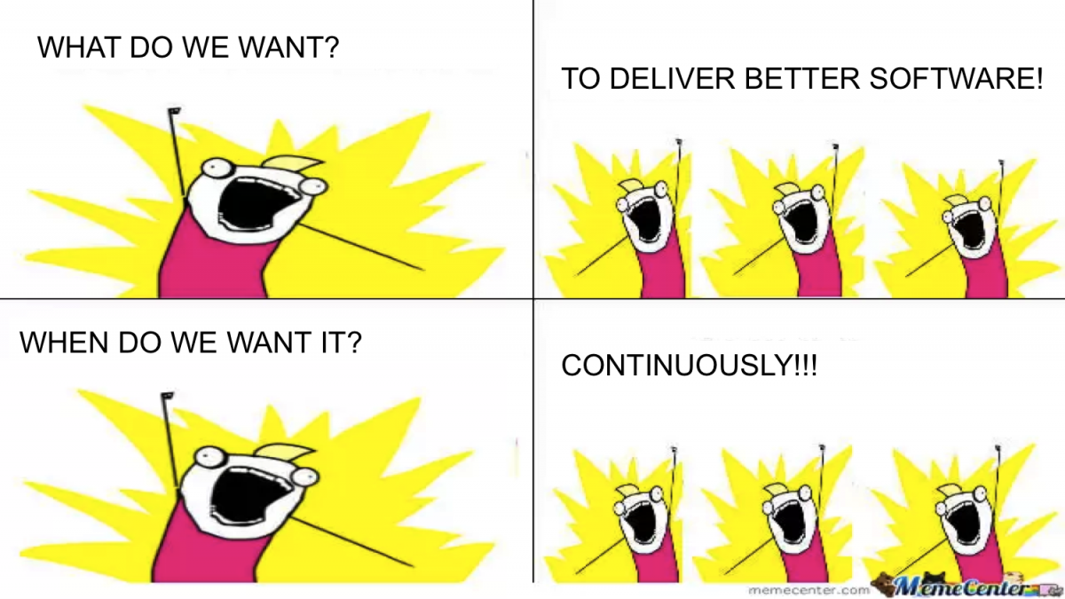



What are Microservices?
Offers coders lots of flexibility,
Increases development velocity
One memory space
But keep in mind what used to be an in memory call is now a Network hop.
Response time and latency impacts will be real
Distributed Microservices
Legacy Applications
Cloud Native Applications
Notes:
Cows = functions (pricing / inventory etc)
Not all good news: Can no longer rely on shared memory space, comms between functions now has to happen across the network.
Each container has to be sized propertly also

Slide 10
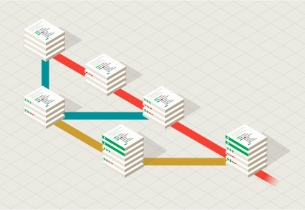
GIT
GIT – an offensive English slang term for “a stupid person”
Created in 2005 by Linus Torvalds (who also developed Linux)
Free open-source software that handles source code versioning
Track local file changes
Share changes with a remote repository
Most widely used modern version control system
https://git-scm.com/
Notes:
GIT – there are other options but this is de facto solution
REPOSITORY
More detail in next session
“Global Information Tracker” — but according to the creator of git, it’s just a stupid/unpleasant person like the creator.
Can be complicated but we only need the basics. Next session is all on GIT. The class is also in the VMware GIT repository (one of the exercise will be to sign up for that)
Dave says “five commands” is all you need to know.

Slide 11
Docker
The most prevalent container system
Abstracts applications similar to how VMware abstracts the Operating System
Allows containers to run “anywhere”: laptop, server, cloud
On its own, Docker lacks needed enterprise features
Notes:
Docker is the second building blocks. Docker started the whole containerization thing (or popularized it anyway) by abstracting the application and allowing it to run anywhere you have Docker installed.
Strips away dependencies
You cannot use Docker to orchestrate hundreds and thousands of containers across multiple servers.

Slide 12
Benefits of Containers
Build
Package all Application Dependencies into an Artifact (Image), independent from the Language or OS
Developer specifies the Runtime Parameters of the App (no Environment Drift)
Ship
Share and consume those Images from a central (public/ private) Repository
Build new Images from existing ones (Efficiency)
Distribute with Confidence (ISVs)
Run
Execute the Container Image as a Container Instance (OS Process, not a full OS thus lightweight)
Isolated by Namespaces (“What the Process can see”)
Resources controlled by cGroups (“What the Process can use”)
Result
Increased Velocity, Resource Usage, Standardization
Notes:
Run on Mac, Linux, cloud
Create image, push into registry (private or public)
You don’t need to know about underlying OS stuff. You don’t have to build and tweak a Linux server to run a particular application
Quicker to develop

Slide 13
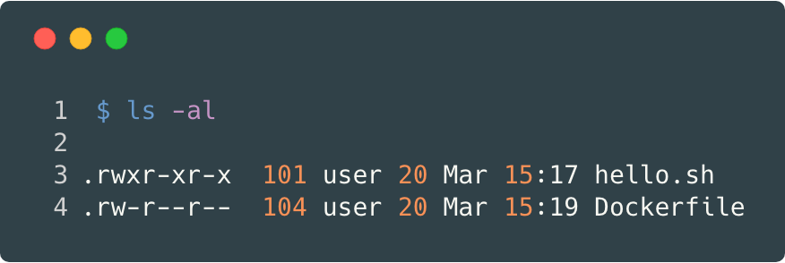
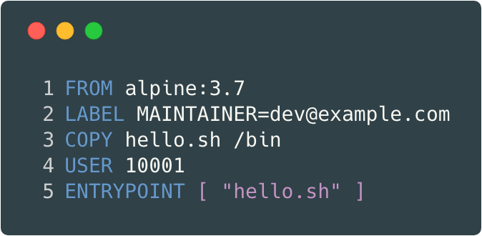
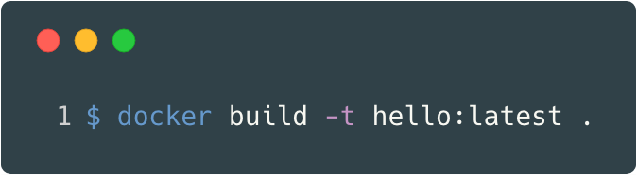
So what is a Container, really? (https://www.youtube.com/watch?v=8fi7uSYlOdc )
Build: Dockerfile
Source Code
Base Image (Layer)
“COPY” adds File and creates a new Layer
Run with User ID != 0 (i.e. not as root)
Execute ”hello.sh” when Container starts
Notes:
More to follow in the Docker session so quickly:

Slide 14
Container vs VM
Notes:
Different level of abstraction. Container very very stripped-down OS level stuff. Can run on any (Docker-supported) OS.
Can have an Ubuntu image running on my laptop in a couple of minutes

Slide 15
Kubernetes
A platform for running containers
The system is declarative
Kubernetes solves enterprise needs for scheduling, resource management, and networking of multiple Docker servers
Kubernetes is an open system that “out of the box” lacks key enterprise subsystems – pick and choose what you want to use:
Identity Management
CNI – Container Network Interface
CSI – Container Storage Interface
DNS – coredns or kube-dns
Ingress
Notes:
“cluster of Docker VMs” (or oher container runtimes).
Declaritive, like Ansible, don’t need to go through all the steps, just tell it the end result and K8S will take care of it - e.g. I want an Apache web server, we tell is I want 1 apache pod of this size created. K8S will create it and watch – if the apache pod dies, K8S “knows” it should have one running so will create another.
If you’re running Apache on Docker and you need to shut down your laptop to go home there is no “vMotion” of Apache over to another Docker server. The concept doesn’t exist. K8S however does allows clustering with “vMotion” etc.
Open Framework -
Identity management – very basic RBAC, not connected to AD or anything like that
CNI – Flannel, Calico (VMware - NSX / Antrea)
CSI – NFS etc VMware = vSAN / vSphere CSI)
Ingress – how do you access the containers – you have to supply that.
Customers: It’s open source, it’s free!? Point them towards Tanzu

Slide 16
Kubernetes – Core Features
[Scheduler] Automatic binpacking, based on priorities, resource limits, reservations, …
[HPA] Easily scale out horizontally
[Replica Sets] Self-healing apps
[Services] Service discovery and load balancing
[Deployments] Automated rollouts and rollbacks
[Secrets/ ConfigMap] Secrets and configuration management
[Persistent Volumes] (Dynamic) Storage orchestration
[Jobs] Batch execution
[DaemonSets] Manage daemon processes in the cluster
[Labels] Act based on tags, filters, conditions
Notes:
We don’t typically re-size (increase size of containers) rather we create more (concurrency)
Replica sets – one of the containers dies, K8S will auto-spin up another to provide set number of replica sets
K8S will automate deployment of your app
Persistent volumes (backing services – remember containers should not be “stateful”) but we might have might have containerized databases (Mongo etc) which then do need persistent storage
Jobs – monitoring and log scraping etc.

Slide 17
Kubernetes Architecture
Overall Architecture
Master/ Worker
API
etcd
PODs
Controllers
Labels
Services
CLI
Notes:
Usually at least three master nodes, some number of working nodes (usually Linux VMs running Docker)
Kubectl – all command through this to API server. Can add more commands over time as we install (e.g.) identity systems etc.
Etcd config etc
Kubelet is the worker-node “agent”

Slide 18
Kubernetes compared to VMware
Basic Kubernetes
https://blogs.vmware.com/cloudnative/2017/10/25/kubernetes-introduction-vmware-users/

Slide 19
How Current Infra is not keeping up with what Devs need
Devs want an on-demand platform for: development, testing, and production
What is part of the Platform?
VMs that host Docker (K8s nodes)
Static IPs
DNS entries
Certificates to secure websites
Security / RBAC
Load Balancers for ingress
Dynamic networks
Logging and Ops metrics
Agility Factors:
Sub 1 hour build time to speed up dev cycles
Consistency - same build process for dev as prod
Take everything that is not development away from Devs

Slide 20
The CI/CD Pipeline
Infrastructure as Code!
CI Server
Developer
Watches git repo
Build new Docker image
Create Branch
Create Code
Push to git
Run Tests
Docker Registry
Push Docker Image
git repo
Create Kubernetes Cluster
Deploy pods to Kubernetes
Automated Testing
Notes:
Our infra needs to change quite a bit

Slide 21
The Entire App Platform
CI/CD Automation Engine
Everything is automated!
Dev
Platform
Infra
GIT Repo - Apps
Docker Registry
CI/CD Automation
Automated Testing
Build API
K8 Nodes
Kubernetes API
K8 Name Resolution
Ingress and Egress
Persistent Storage
Internal Networks
Logging – Apps
Tracing – Apps
Ops – metrics
Ops – Alerting
RBAC
Service Mesh
Service Federation
Identity Management Workspace One
Certificate Management
GIT Repo – Infra
IP Management
DNS
Kubernetes PKS, Tanzu TKG
Registry Harbor
Load Balancers NSX-T
Firewall NSX-T
Virt Networks NSX-T
Service Mesh NSX-T SM
Capacity vROPs
Metrics vROPs, Wavefront
Alerting vROPs, Wavefront
Logging logInsight, Wavefront
Storage vSAN, vSphere
Automation CodeStream
K8 nodes vSphere
Platform VCF
Notes:
Who is even doing fully-automated IP management? Let alone certs etc.

Slide 22
Cloud Provider demo
Why are Devs using Google or AWS vs on-premise services?
On-demand
API interface for ALL services that works well with DevOps engines
Identity Management
IP and DNS
gcloud compute addresses create test-static-1 --project=citric-replica-300516 --network-tier=STANDARD --region=us-east1
Certificate Management
Create VMs
Create Kubernetes cluster

Slide 23
Basic Linux Competency
If you struggle with Linux – you need to become competent in at least the following
Secure Shell (ssh) - logging into a session
Private and public keys.
Directory navigation
File editing (vi)
Rights escalation or swap with sudo and su
Process navigation and killing
Installing packages (yum and apt-get)
DNS tools and debugging
curl

Slide 24
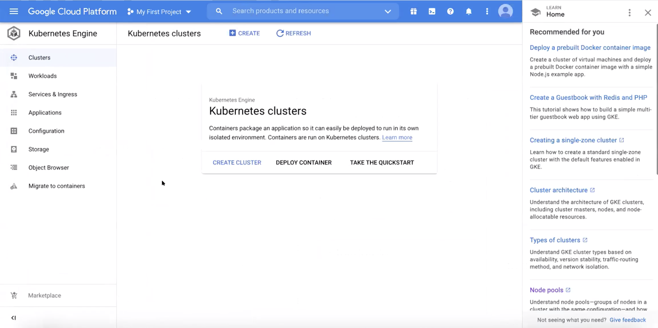

Slide 25
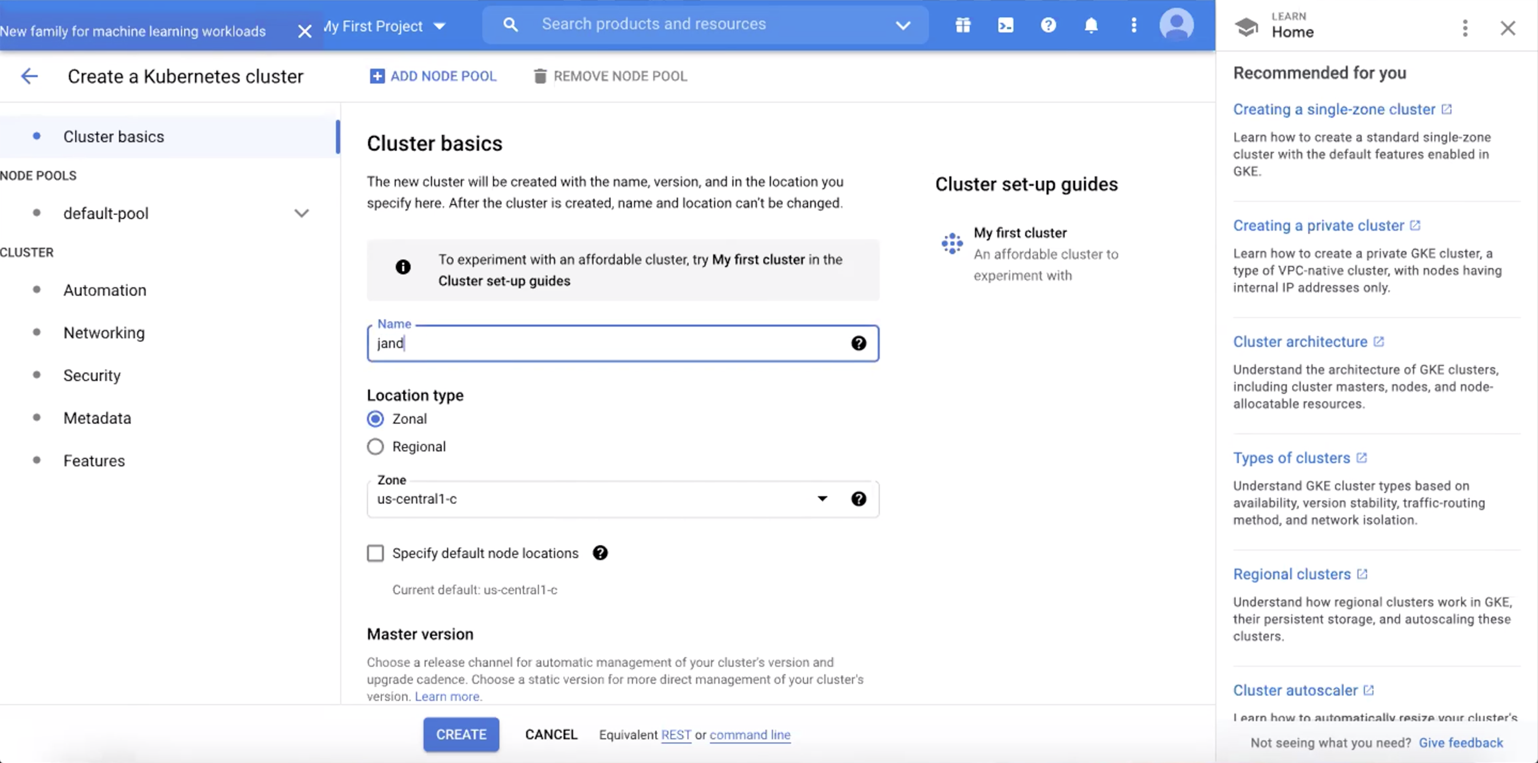

Slide 26
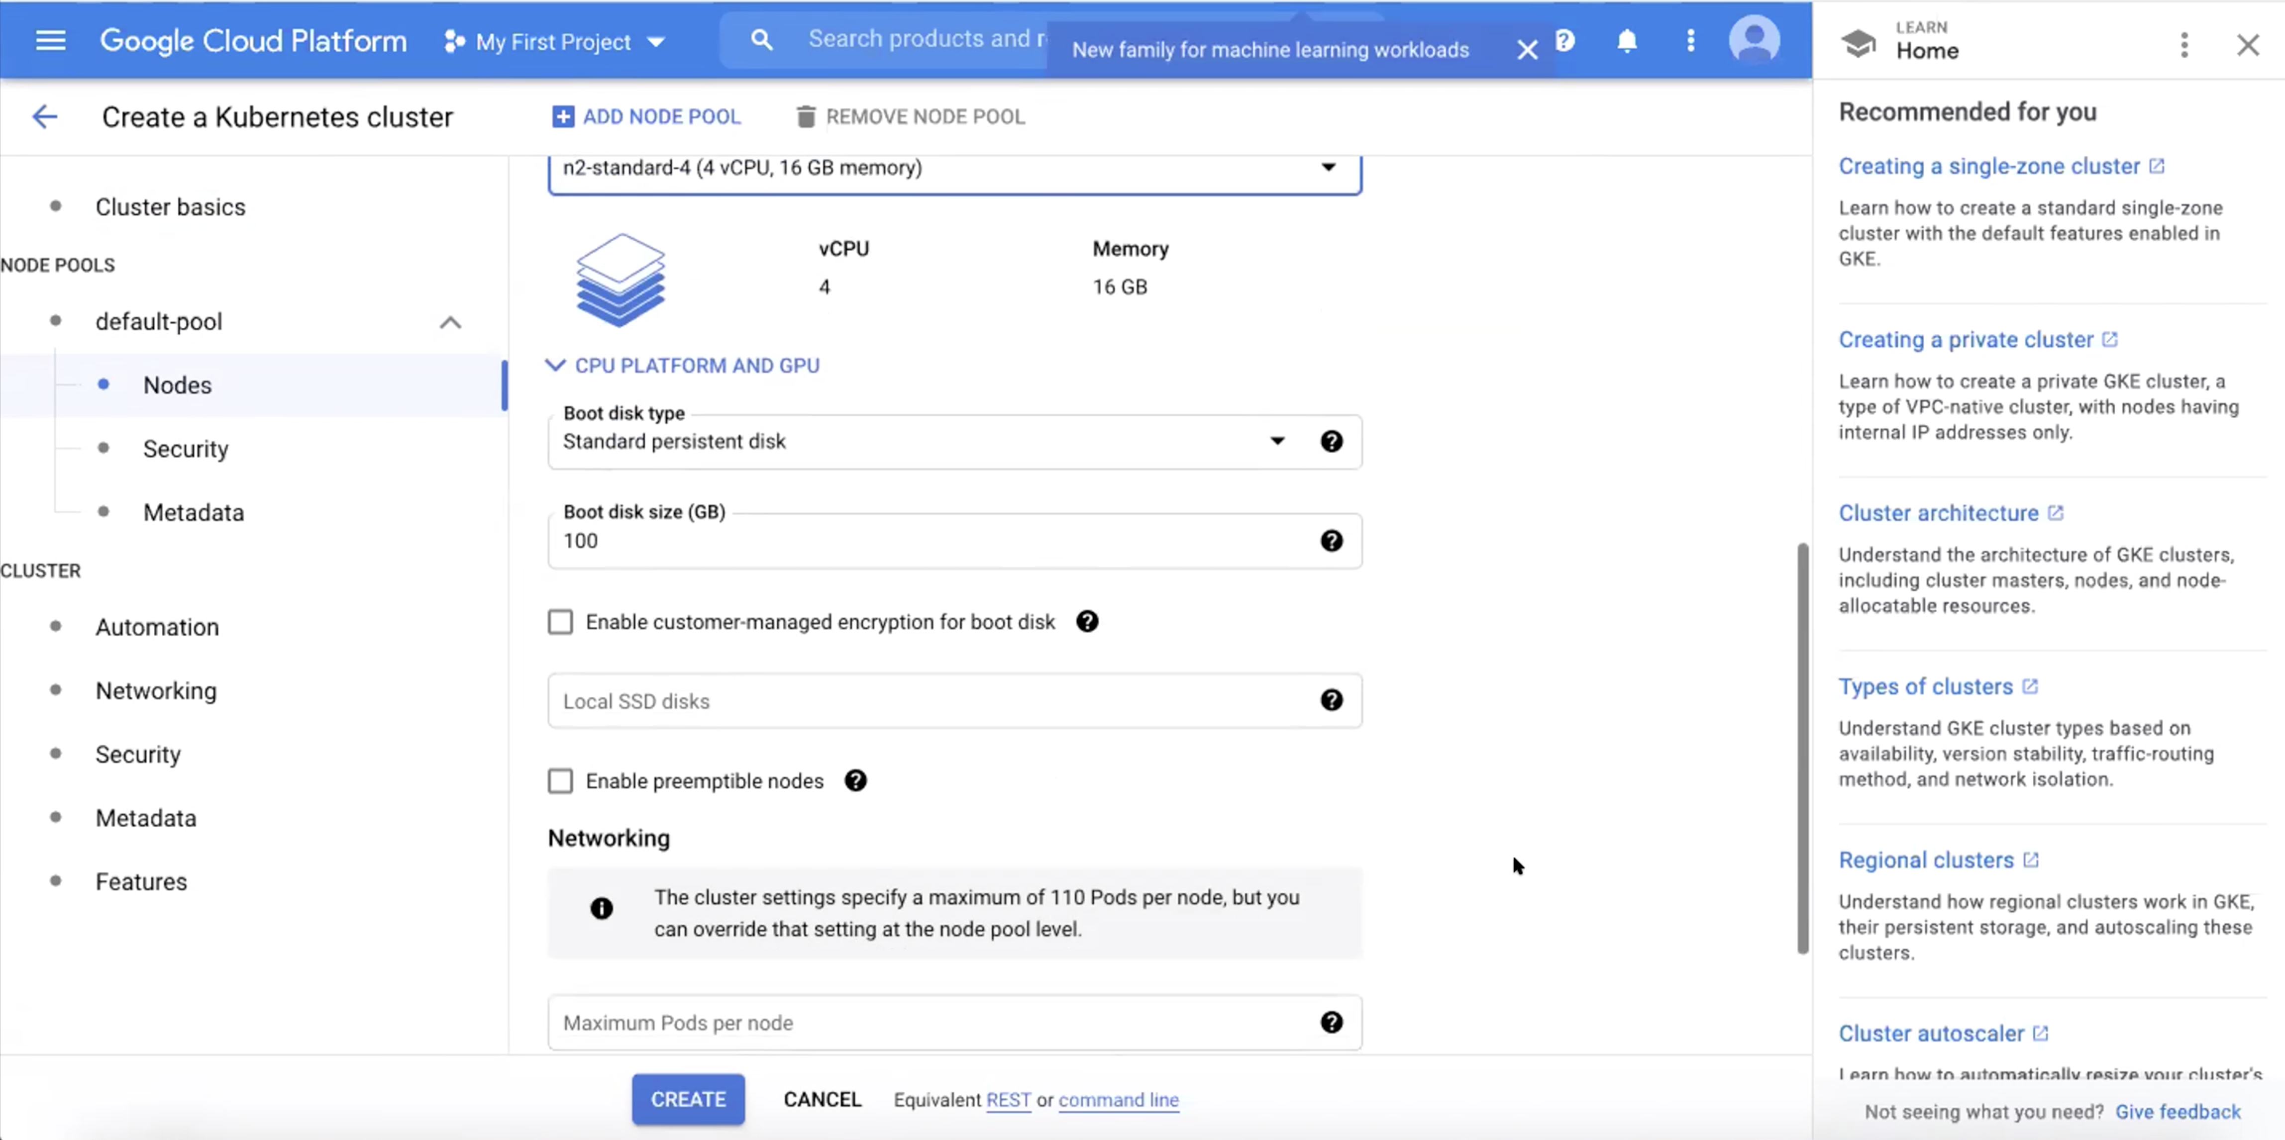

Slide 27
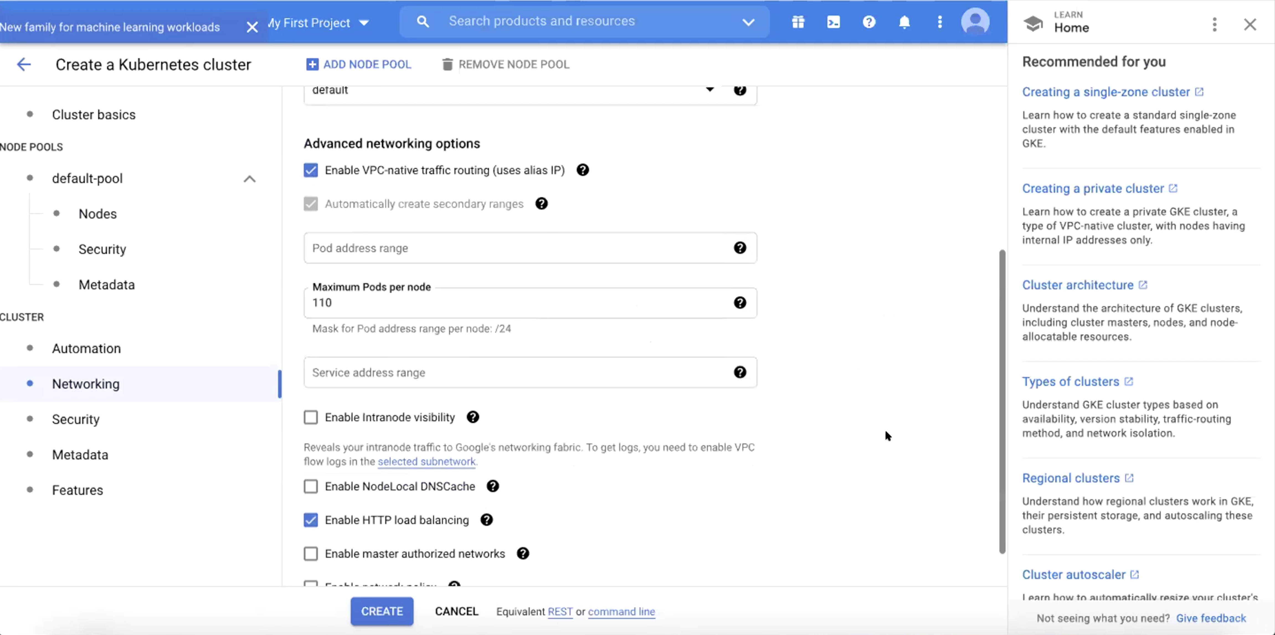

Slide 28
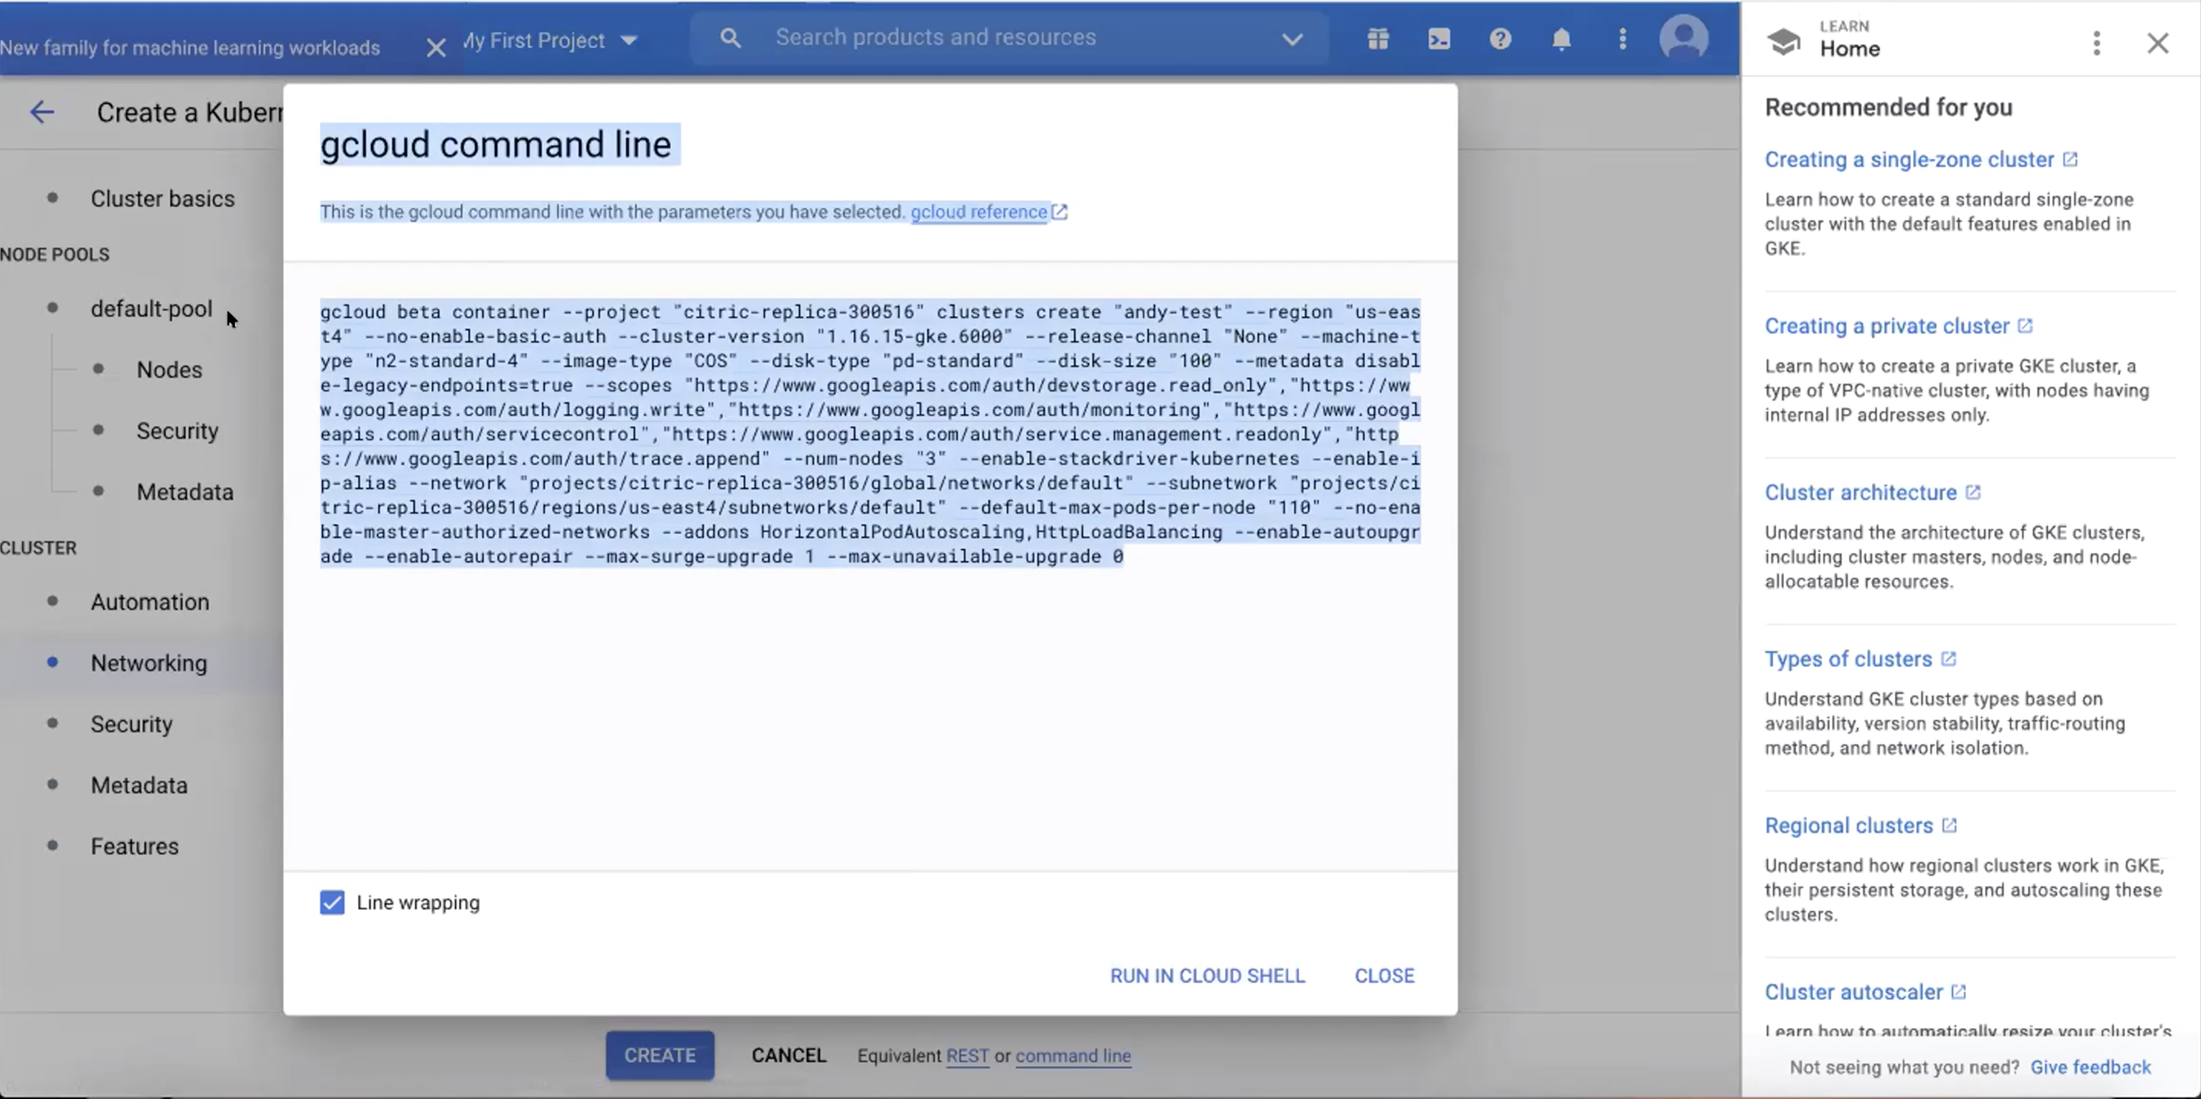

Slide 29
Lab Homework
For the next 2 weeks
Work on Linux skills

